Slide 1

The
Kentucky Immunization Registry

Slide 2
Objectives
Describe the KY Immunization Registry
Understand the importance of pharmacy participation in KYIR
Learn how KYIR can help pharmacies
Understand process to enroll and participate

Slide 3
What is KYIR?
Statewide Immunization Registry
  Confidential, population-based, computerized database that records all immunization doses administered by participating providers to persons residing within a given geopolitical area
  Birth to Death- follows patients for entire vaccinating lifespan
  Includes standard tools like patient immunization histories, dose forecasting according to ACIP recommendations, next dose reminder-recall, and official immunization records for school entry
  Allows providers the ability to access and retrieve immunization records prior to or at the time of a scheduled appointment.

Slide 4
What is KYIR?
At the point of clinical care, KYIR can provide consolidated immunization histories for use by a vaccination provider in determining appropriate client vaccinations
At the population level, an immunization registry provides aggregate data on vaccinations for use in surveillance and program operations, and in guiding public health action with the goals of improving vaccination rates and reducing vaccine-preventable disease.

Slide 5
What Data is Contained in KYIR?
Vital Records Demographic Data only from January 1, 2007 to present (imported daily)
Local Health Department (LHD) immunization data was imported from January 1, 1996 to August 2015
Since August 2015 LHD’s manually enter all vaccination doses into KYIR system
Electronic submission data from a facility EHR or Health Information System to KYIR (facilitated through the Kentucky Health Information Exchange).

Slide 6
KYIR Data Flow
Vital Records
Electronic Submission through provider EHRs
Manual Entry
Flat File Upload
Patient Demograp-hics
Birth HepB and HBIG
Patient Demographics
Newly Administered Vaccines
Historical Vaccines
Patient Demograp-hics
Newly Administered Vaccines
Historic Vaccines
Patient Demograp-hics
Historic
Vaccines
Kentucky Health Information Exchange
Kentucky Immunization Registry
Kentucky Health Information Exchange:
*Bi-directional Query
Front End User Interface
Notes:
Manual Entry = Full reporters…information goes directly into KYIR and does not require KHIE Connection. Many pharmacies use this route.
Flat File Uploads – Historic Data gets put into KYIR
Electronic Submission Through Provider EHR (Bidirectional) = Can pull data back out of KYIR to populate your pharmacy health record. Allows automatic submission of pharmacy immunization data to KYIR through KHIE
VFC= Aggregate reporters

Slide 7
Pharmacies
KYIR Data Flow
Pharmacies
Vital Records
Electronic Submission through provider EHRs
Manual Entry
Flat File Upload
Patient Demograp-hics
Birth HepB and HBIG
Patient Demographics
Newly Administered Vaccines
Historical Vaccines
Patient Demograp-hics
Newly Administered Vaccines
Historic Vaccines
Patient Demograp-hics
Historic
Vaccines
Kentucky Health Information Exchange
Kentucky Immunization Registry
Kentucky Health Information Exchange:
*Bi-directional Query
Front End User Interface
Notes:
Manual Entry = Full reporters…information goes directly into KYIR and does not require KHIE Connection. Many pharmacies use this route.
Flat File Uploads – Historic Data gets put into KYIR
Electronic Submission Through Provider EHR (Bidirectional) = Can pull data back out of KYIR to populate your pharmacy health record. Allows automatic submission of pharmacy immunization data to KYIR through KHIE
VFC= Aggregate reporters

Slide 8
Points of Care Submitting Electronic Data
Through Kentucky Health Information Exchange (KHIE)
  2025 total Points of Care Live (sending data electronically to KYIR)
  Plus 278 in the queue or testing with us
  230 Pharmacy sites live including: Wal-Mart/SAMS Club and CVS
Manual Data Entry from VFC Providers without an EMR- including all Health Departments and many pharmacies
Numbers are as of 08/2020

Slide 9
How Can KYIR Help Your Pharmacy?
KYIR has been live since December 2015
Any clinic, hospital, pharmacy, nursing home employee, and school nurse can apply for access to KYIR.
Since it is a birth to death registry, its utility appeals to many different provider types, including pharmacies
Having all providers report to the registry allows for complete vaccine records

Slide 10
How Can KYIR Help Your Pharmacy?
KYIR Enrollment is a Requirement for Participation in the Federal/State COVID-19 Vaccine Program
Research historical records to determine if patient is due for vaccines at the time of visit.
Access to the vaccine recommender to ensure a patient’s immunization status is current, accurate, and consistent.
  The vaccine recommender will let a healthcare provider know what vaccines are currently due at the time of visit or what vaccines are coming due in the future for their patients.
Notes:
The federal government is requiring that any provider that wants access to order and administer COVID-19 vaccine must be enrolled in their state immunization information system (IIS). Our state IIS is the Kentucky Immunization Registry (KYIR), therefore, participation in KYIR is mandatory for providers, including pharmacies.

Slide 11
How Can My Pharmacy Participate in KYIR?
Option 1: Connect to the Kentucky Health Information Exchange (KHIE)
If you would like to connect to KHIE to establish an electronic connection from your Pharmacy EHR to KYIR please visit KHIE’s website here
  With an electronic connection, data flows automatically to KYIR without the need to manually log in and record doses administered
  Vaccine documentation process becomes part of normal prescription workflow
  This process takes longer to complete due to the EHR testing phase. *
*It may take some time to get through the testing phase before your pharmacy is “Live” with KYIR.

Slide 12
How Can My Pharmacy Participate in KYIR?
Option 2: Enroll in the Web-Based Application directly with KYIR
This option is best if your pharmacy cannot connect to KHIE or does not have an existing EHR system in place.
The enrollment process usually takes two weeks to complete
The web-based application to allows pharmacies to manually input immunization doses administered
Allows pharmacies to utilize existing tools within KYIR such as researching patient records and using the vaccine recommender
Mass vaccination tool allows pharmacies to manually enter multiple patients quickly during immunization clinics
  Enroll with us by completing the enrollment forms found on our webpage here
    Forms may be emailed to KYIRHelpdesk@ky.gov

Slide 13
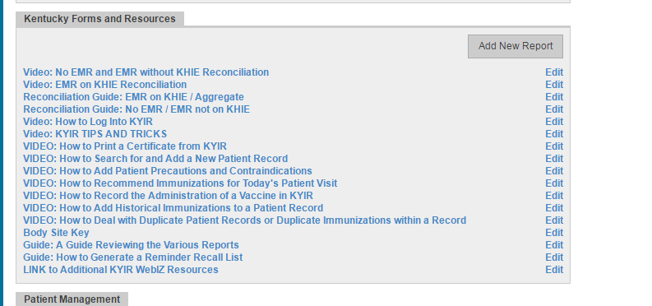
Training Materials
Training materials found under the Reports/ Training Module in KYIR

Slide 14

Contact Us
The KYIR Helpdesk
  Open Monday - Thursday 8a.m. - 4p.m and Friday 8a.m.– 12p.m.
  Use the email option after 12p.m. on Fridays
  Phone: 502-564-0038
  Email: KYIRHelpdesk@ky.gov

